Slide 1

.NET Core App Secret Management
Mike Branstein
Louisville .NET Meetup, July 2019

Slide 2
About Me
KiZAN Technologies
Cloud Solution Architect
Azure Solutions
Cloud Governance, Cost Management
DevOps
CICD Automation Strategy
Azure DevOps (TFS), migrations, implementations, etc.
Strategic Account Customer Success
Healthcare Industry Focus

Slide 3
What’s your problem?
You need to share code
Your app needs certain config values to run
Usernames
Passwords
Connection strings
Access keys
You don’t want to source control secrets

Slide 4

What’s a Dev To Do?

Slide 5
Developing a secret management strategy
Relatively easy for new devs to use/understand
Secrets aren’t source controlled
Configuration is “swappable” at release
Works for multiple environments

Slide 6
Understanding the Options
AppSettings.json
User Secrets
Environment Variables
Tokenization and Substitution
External Secret Store

Slide 7
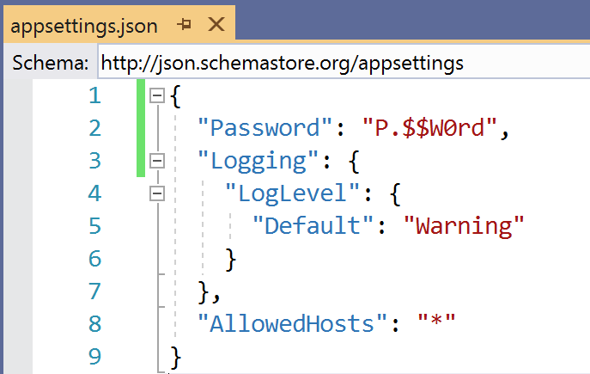
AppSettings.json
Simplest and usually default method of storing configuration and secrets
Using this causes this the problems we just discussed

Slide 8
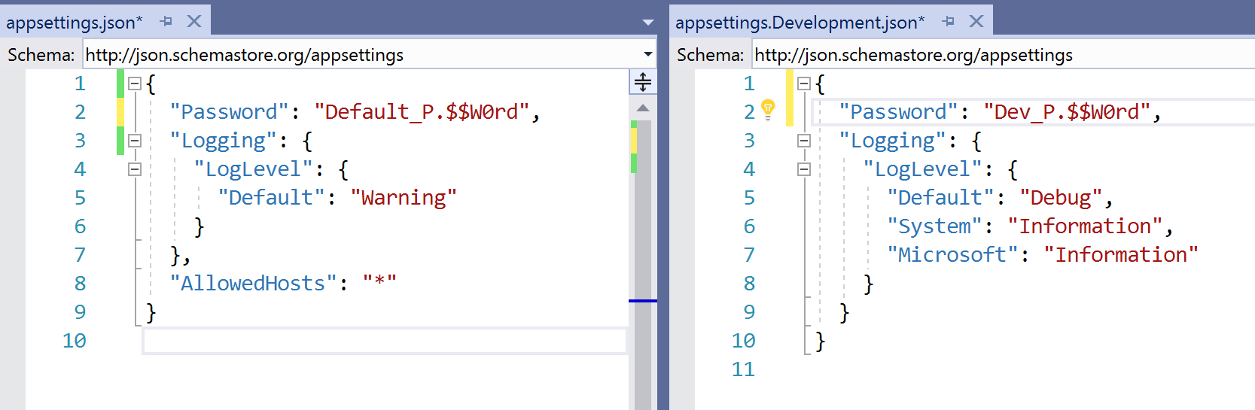
Environment-specific settings
AppSettings.{Environment}.json for environment-specific configurations

Slide 9
AppSettings.json Pros/Cons
Storing secrets directly is not a good idea – it’s source controlled
It’s plain-text, not encrypted
There are techniques with the Environment-specific settings
We will revisit this

Slide 10
User Secrets
New to .NET Core
The Secret Manager tool stores sensitive data
Behind the scenes, it stores secret data in a JSON configuration file
%APPDATA%\Microsoft\UserSecrets\<user_secrets_id>\secrets.json
.microsoft/usersecrets/<user_secret_id>/secrets.json Add secrets via command line
Extract secrets with app code

Slide 11
User Secrets Demo

Slide 12
User Secrets Pros/Cons
Great for development, not for production
Easy to configure, built-in to .NET Core
Secret data is not encrypted, stored in user profile
If machine is compromised, secrets are compromised

Slide 13
Environment Variables
Similar to user secrets – stored external to the app
Managed by OS
You extract the secrets with app code

Slide 14
Environment Variables Demo

Slide 15
Environment Variable Pros/Cons
Easy to set & read
B/c they’re global, conflicts if 2 apps have the same env. variable name
Values not encrypted
If machine is compromised, secrets are compromised

Slide 16
Tokenization and Substitution
This option builds on AppSettings.json
Create an AppSettings.Production.json configuration
Add secrets with placeholders/token values
Replace tokens in CICD Release Pipeline before deployment

Slide 17
Tokenization and Substitution Demo

Slide 18
Tokenization and Substitution Pros/Cons
Secrets are not source controlled, only tokens
Secrets are stored in plain-text, not encrypted
If the machine is compromised, secrets are compromised

Slide 19
External Secret Store
Organization may have a secrets management platform
HashiCorp Vault
Azure Key Vault
When app loads
Communicates with secret store
Reads secrets
Dynamically stores in memory

Slide 20
External Secret Store Demo

Slide 21
External Secret Store Pros/Cons
Not great for development, has dependency on 3rd party system
Secrets are stored securely, encrypted
If machine is compromised, secrets aren’t compromised

Slide 22
Recommendations
Configure your CICD Pipelines, Don’t Deploy from Visual Studio
Don’t store secrets in appsettings.json. Ever.

Slide 23
Development Recommendations
Use User Settings
Add notes in project README for required restrict the loading of these values in non-dev environments
Fail gracefully when a config value isn’t found

Slide 24
Production Recommendations
Use External Secret Store
Cloud – Key Vault, with MSI auth token
On Premises – Key Vault or another system
Pair with Tokenization approach to store external secret store auth token

Slide 25
Thank you
Mike Branstein
@mikebranstein
github.com/mikebranstein
brosteins.com

